Slide 1
Testing the User Interface
Android Developer Fundamentals
Lesson 6
This work is licensed under a Creative Commons Attribution-NonCommercial 4.0 International License
This work is licensed under a Creative Commons Attribution-NonCommercial 4.0 International License

Slide 2
6.1 Testing the User Interface
This work is licensed under a Creative Commons Attribution-NonCommercial 4.0 International License
This work is licensed under a Creative Commons Attribution-NonCommercial 4.0 International License

Slide 3
Contents
Testing Methods
Automated Testing
Using Espresso
Testing Environment and Setup
Creating Espresso Tests
Espresso Test Examples
Recording Tests

Slide 4
Testing Methods

Slide 5
User interface testing
Perform all user UI actions with views
Tap a UI view, and enter data or make a choice
Examine the values of the properties of each view
Provide input to all UI views
Try invalid values
Check returned output
Correct or expected values?
Correct presentation?

Slide 6
Problems with testing manually
Time consuming, tedious, error-prone
UI may change and need frequent retesting
Some paths fail over time
As app gets more complex, possible sequences of actions may grow non-linearly

Slide 7
Benefits of testing automatically
Free your time and resources for other work
Faster than manual testing
Repeatable
Run tests for different device states and configurations

Slide 8
Espresso for single app testing
Verify that the UI behaves as expected
Check that the app returns the correct UI output in response to user interactions
Navigation and controls behave correctly
App responds correctly to mocked-out dependencies

Slide 9
UI Automator for multiple apps
Verify that interactions between different user apps and system apps behave as expected
Interact with visible elements on a device
Monitor interactions between app and system
Simulate user interactions
Requires instrumentation

Slide 10
What is instrumentation?
A set of hooks in the Android system
Loads test package and app into same process, allowing tests to call methods and examine fields
Control components independently of app’s lifecycle
Control how Android loads apps

Slide 11
Benefits of instrumentation
Tests can monitor all interaction with Android system
Tests can invoke methods in the app
Tests can modify and examine fields in the app independent of the app’s lifecycle

Slide 12
Testing Environment & Setup

Slide 13
Install Android Support Library
In Android Studio choose Tools > Android > SDK Manager
Click SDK Tools and look for Android Support Repository
If necessary, update or install the library

Slide 14
Add dependencies to build.gradle
androidTestCompile 'com.android.support:support-annotations:24.1.1'
androidTestCompile 'com.android.support.test:runner:0.5'
androidTestCompile 'com.android.support.test:rules:0.5'
androidTestCompile 'org.hamcrest:hamcrest-library:1.3'
androidTestCompile
'com.android.support.test.espresso:espresso-core:2.2.2'
androidTestCompile
'com.android.support.test.uiautomator:uiautomator-v18:2.1.2'

Slide 15
Add defaultConfig dependencies
testInstrumentationRunner
"android.support.test.runner.AndroidJUnitRunner"

Slide 16
Prepare your device
Turn on USB Debugging
Turn off all animations in Developer Options > Drawing
Window animation scale
Transition animation scale
Animator duration scale

Slide 17
Create tests
Store in module-name/src/androidTests/java/
In Android Studio: app > java > module-name (androidTest)
Create tests as JUnit classes

Slide 18
Writing Espresso Tests

Slide 19
Test class definition
@RunWith(AndroidJUnit4.class) // Required annotation for tests
@LargeTest // Based on resources the test uses and time to run
public class ChangeTextBehaviorTest {}
@SmallTest—Runs in < 60s and uses no external resources
@MediumTest—Runs in < 300s, only local network
@LargeTest—Runs for a long time and uses many resources

Slide 20
@Rule specifies the context of testing
@Rule
public ActivityTestRule<MainActivity> mActivityRule =
new ActivityTestRule<>(MainActivity.class);
@ActivityTestRule—Testing support for a single specified activity
@ServiceTestRule—Testing support for starting, binding, shutting down a service

Slide 21
@Before and @After set up and tear down
@Before
public void initValidString() {
mStringToBetyped = "Espresso";
}
@Before—Setup, initializations
@After—Teardown, freeing resources

Slide 22
@Test method structure
@Test
public void changeText_sameActivity() {
// 1. Find a View
// 2. Perform an action
// 3. Verify action was taken, assert result
}

Slide 23
"Hamcrest" simplifies tests
“Hamcrest” an anagram of “Matchers”
Framework for creating custom matchers and assertions
Match rules defined declaratively
Enables precise testing
The Hamcrest Tutorial

Slide 24
Hamcrest Matchers
ViewMatcher—find Views by id, content, focus, hierarchy
ViewAction—perform an action on a view
ViewAssertion—assert state and verify the result

Slide 25
Basic example test
@Test
public void changeText_sameActivity() {
// 1. Find view by Id
onView(withId(R.id.editTextUserInput))
// 2. Perform action—type string and click button
.perform(typeText(mStringToBetyped), closeSoftKeyboard());
onView(withId(R.id.changeTextBt)).perform(click());
// 3. Check that the text was changed
onView(withId(R.id.textToBeChanged))
.check(matches(withText(mStringToBetyped)));
}

Slide 26
Finding views with onView
withId()—find a view with the specified Android id
onView(withId(R.id.editTextUserInput))
withText()—find a view with specific text
allOf()—find a view to that matches multiple conditions. Find a visible list item with the given text:
onView(allOf(withId(R.id.word),
withText("Clicked! Word 15"),
isDisplayed()))

Slide 27
onView returns ViewInteraction object
If you need to reuse the view returned by onView
Make code more readable or explicit
check() and perform() methods
ViewInteraction textView = onView(
allOf(withId(R.id.word), withText("Clicked! Word 15"), isDisplayed()));
textView.check(matches(withText("Clicked! Word 15")));

Slide 28
Perform actions
Perform an action on the view found by a ViewMatcher
Can be any action you can perform on the view
// 1. Find view by Id
onView(withId(R.id.editTextUserInput))
// 2. Perform action—type string and click button
.perform(typeText(mStringToBetyped), closeSoftKeyboard());
onView(withId(R.id.changeTextBt)).perform(click());

Slide 29
Check result
Asserts or checks the state of the view
// 3. Check that the text was changed
onView(withId(R.id.textToBeChanged))
.check(matches(withText(mStringToBetyped)));

Slide 30
When a test fails
Test
onView(withId(R.id.text_message))
.check(matches(withText("This is a failing test.")));
Result snippet
android.support.test.espresso.base.DefaultFailureHandler$AssertionFailedWithCauseError: 'with text: is "This is a failing test."' doesn't match the selected view.
Expected: with text: is "This is a failing test."
Got: "AppCompatTextView{id=2131427417, res-name=text_message ...

Slide 31
Recording Tests

Slide 32
Recording an Espresso test
Android Studio 2.2
Use app normally, clicking through the UI
Editable test code generated automatically
Add assertions to check if a view holds a certain value
Record multiple interactions in one session, or record multiple sessions

Slide 33
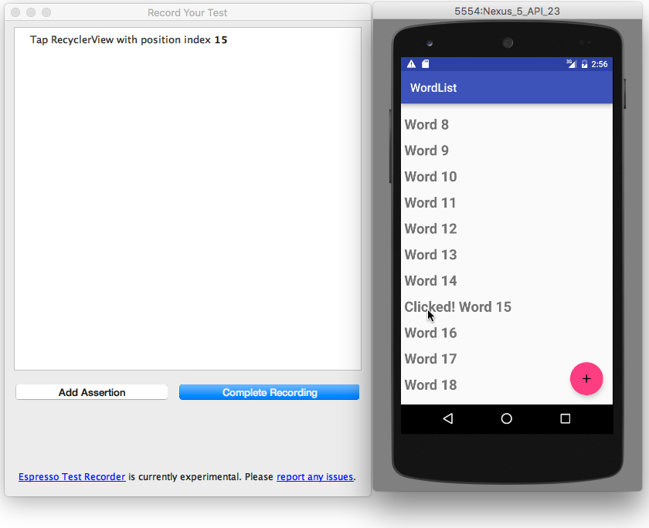
Start recording an Espresso test
Run > Record Espresso Test
Click Restart app, select target, and click OK
Interact with the app to do what you want to test

Slide 34
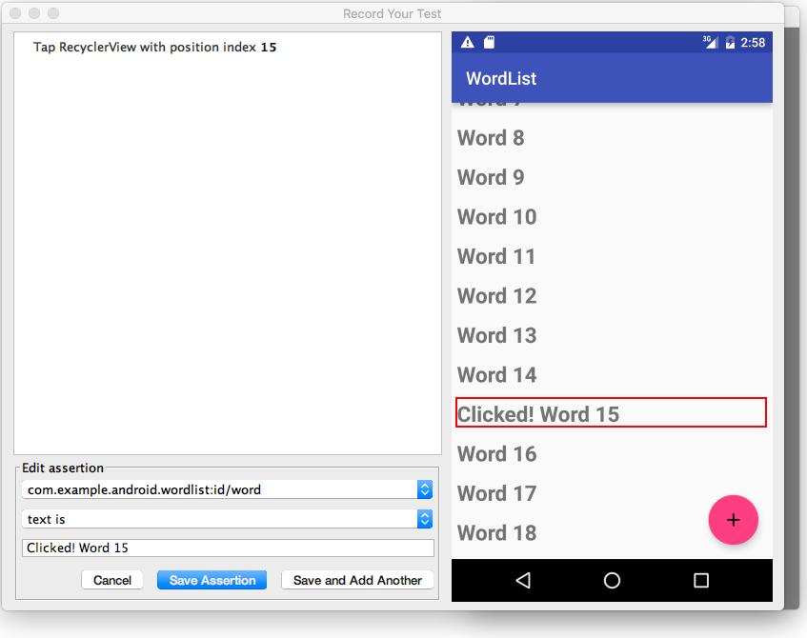
Add assertion to Espresso test recording
Click Add Assertion and select a UI element
Choose text is and enter the text you expect to see
Click Save Assertion and click Complete Recording

Slide 35
Learn more from developer docs
Android Studio Documentation
Test Your App
Espresso basics
Espresso cheat sheet
Android Developer Documentation
Best Practices for Testing
Getting Started with Testing
Testing UI for a Single App
Building Instrumented Unit Tests
Espresso Advanced Samples
The Hamcrest Tutorial
Hamcrest API and Utility Classes
Test Support APIs

Slide 36
Learn even more
Android Testing Support Library
Espresso documentation
Espresso Samples
Videos
Android Testing Support - Android Testing Patterns #1 (introduction)
Android Testing Support - Android Testing Patterns #2 (onView view matching)
Android Testing Support - Android Testing Patterns #3 (onData & adapter views)

Slide 37
Learn even more
Google Testing Blog: Android UI Automated Testing
Atomic Object: “Espresso – Testing RecyclerViews at Specific Positions”
Stack Overflow: “How to assert inside a RecyclerView in Espresso?”
GitHub: Android Testing Samples
Google Codelabs: Android Testing Codelab

Slide 38
What's Next?
Concept Chapter: 6.1 C Testing the User Interface
Practical: 6.1 P Use Espresso to Test Your UI

Slide 39
END

